Slide 1
Requirements Engineering
Requirements Elicitation
George Edwards
Computer Science Department
University of Southern California
gedwards@usc.edu

Slide 2
Agenda
Today:
Quiz on Chapter 2
Lecture on Chapter 3
Homework discussion on Chapter 3
Next week:
Quiz on Chapter 3
Lecture on Chapter 4
Homework discussion on Chapter 4
Project description and modeling lesson

Slide 3
Student Presentations
Grading Criteria
Demonstrate understanding of the technical content (50%)
Summary of the content
Clarity
Evaluate and critique the paper (30%)
Identify specific strengths and weaknesses
Propose alternative ideas or approaches
Other (20%)
Engage the audience
Pose interesting and thought provoking questions for discussion
Able to answer instructor questions

Slide 4
DEN Student Presentations
May be given in class or recorded
To record your presentation:
Start a meeting in Bluejeans
Record the meeting
Share the meeting with me and Jai (jkhanna@usc.edu)
Upload the recorded presentation before class on the day that your paper is assigned
The presentations will be played to the class if we have time

Slide 5
Requirements Elicitation

Slide 6
Survey of Techniques
Brainstorming
Card Sorting
Designer as Apprentice
Domain Analysis
Ethnographic Observation
Goal Based Approaches
Group Work
Interviews
Introspection
Joint Application Design (JAD)
Laddering
Protocol Analysis
Prototyping
Quality Function Deployment (QFD)
Questionnaires
Repertory Grids
Scenarios
Task Analysis
User Stories
Viewpoints
Workshops

Slide 7
Organizing Elicitation Techniques
Interaction with stakeholders How should we gather information? |  | Concepts and constructs What information should we capture? |  | Management and organization How should we organize the information?
Technique | Example | Technique | Example | Technique | Example
Brainstorming | Mind mapping | Goals | GQM, KAOS | Hierarchy and decomposition | Goal decomposition
Questionnaires | Online polls | Scenarios and processes | User stories, use cases, sequence diagrams | Viewpoints | Structural and behavioral views
Interviews | Laddering | Functions, tasks, and features | Card sorting | Priorities | Repertory grids
Workshops | JAD | Mockups and prototypes | Storyboards, UI mockups, simulations
Observation | Designer as app., ethnographic, protocol analysis
Domain analysis
Introspection

Slide 8
Interaction with Stakeholders
Brainstorming
Questionnaires
Interviews
Workshops
Observation
Domain analysis
Introspection

Slide 9
Brainstorming
Approach: REs hold an informal meeting with stakeholders to consider new ideas for the system
May consist of a single individual or a small group
Focus is on idea generation, not evaluation
Formality may be inversely proportional to creativity
Example: Mind mapping

Slide 10
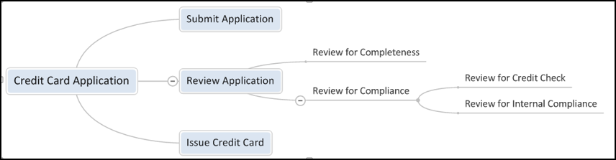
Mind Mapping
Simple, graphical technique to capture thoughts by connecting ideas to a central subject in a tree structure
Used in many areas
Good (free) tool support available

Slide 11
Brainstorming: Advantages and Disadvantages
Advantages | Disadvantages
Can be used when little is known about the system | Most effective with face-to-face interaction
May lead to unexpected/innovative ideas and solutions | May result in many dead ends (low quality solutions, infeasible/unrealistic ideas)
Useful for generating the mission statement
Little or no training required

Slide 12
Questionnaires and Surveys
Approach: RE sends a list of questions to stakeholders and compiles the answers
May be used with a very large number of stakeholders
Survey questions can be closed (e.g. multiple choice, true false) or open-ended
Danger in over-scoping and under-scoping if questions are not adequately framed
Most useful when the domain is very well understood by both stakeholders and RE
Example: Online questionnaire

Slide 13
Some Questions for Pet Store POS
How many unique products (SKUs) do you carry in your inventory
a) 0-1000 b) 1001-10,000 c) 10,001-100,000 d) > 100,000
How many different warehouse sites do you have? ____
How many different store locations do you have? ____
How many unique customers do you currently have? ____

Slide 14
Questionnaires: Advantages and Disadvantages
Advantages | Disadvantages
Does not require co-location | May restrict scope of stakeholder input
Allows input from a very large number of stakeholders | May overlook important issues
Helps to quickly define the project scope | May lead to misunderstanding/misinterpretation
Can produce quantified information

Slide 15
Interviews
Approach: REs ask a stakeholder questions and record the answers
Generally used with a single stakeholder at a time
Three kinds of interviews exist
Unstructured – conversational, can be hit-or-miss based on skill of interviewer
Structured – uses pre-defined questions that have been rigorously planned
Semi-structured – uses combination of the above
Care must be taken to ensure all of the right questions are asked
Templates are very helpful when in employed with interviewing
Example: Laddering

Slide 16
Sample Interview Questions
Name an essential feature of the system? Why is this feature important?
How important is this feature with respect to other features?
What other features are dependent of this feature?
What other features must be independent of this feature?
What other observations can you make about this feature?

Slide 17
Laddering
Uses short prompting questions (“probes”) to elicit requirements
Follow up questions dig deeper below the surface
Assumes that information can be arranged in a hierarchical fashion
Resultant information is then organized in some kind of tree structure

Slide 18
Laddering: Pet Store
Name a key feature of the system?
Customer identification
How do you identify a customer?
They can swipe their loyalty card
What if a customer forgets their card?
They can be looked up by phone number
When do you get the customer’s phone number?
When they complete the application for the loyalty card
How do they complete the applications….

Slide 19
Laddering
Customer loyalty management
Application processing
Customer identification
Swipe card processing
Customer id lookup

Slide 20
Interviews: Advantages and Disadvantages
Advantages | Disadvantages
Allows direct and detailed input from stakeholders | Most effective with face-to-face interaction
Allows the RE to structure and focus the discussion on important issues | Large time commitment
Minimizes the chance of miscommunications on topics covered | Difficult to use with a large number of stakeholders
 | May overlook important issues if they are not included in the interview questions
 | Conducting effective interviews takes practice and skill

Slide 21
Workshops
Approach: RE organizes a gathering of stakeholders to hammer out requirements issues
Most effective with a small- to medium-sized group
Formal workshops are well planned but can be boring and tiring
Informal workshops can be more lively, but overlook important elements
Example: JAD

Slide 22
Workshops: Advantages and Disadvantages
Advantages | Disadvantages
Facilitates communication | Difficult to organize and focus the many stakeholders involved
Builds relationships among stakeholders | Problems of openness and candor can occur
Allows rapid progress to be made in a short amount of time | Certain individuals can dominate
Expedites decision making; provides opportunity to get “buy-in” from all stakeholders on critical issues | Can lead to feelings of being “left out” by those not in attendance
 | Large time commitment/high cost

Slide 23
Observation
Approach: REs observe users working, possibly participating and asking questions
Includes one or more REs and one or more stakeholders
REs can be passive, active, or both
Examples: Designer as apprentice[re is active], ethnographic observation[re is passive as we make observations and not do anything but just observe], protocol analysis[ re is both active and passive]

Slide 24
Ethnographic Observation
Based on detailed observations of human activity.
Involves long periods of observation (hence, an objection)
Direct and indirect evidence is gathered
The work or activity itself
Evidence derived from the surroundings that may not be communicated directly

Slide 25
Protocol Analysis
Process where customers walk through the process that they are going to automate
Customers explicitly state the rationale for each step that is being taken
To identify bottlenecks, inefficiencies and all. And motive is to reduce them
Very similar to designer as apprentice
Differences lie in the role of the RE – he/she is more passive in protocol analysis

Slide 26
Observation: Advantages and Disadvantages
Advantages | Disadvantages
Often reveals tacit knowledge | Most effective with face-to-face interaction
Fosters a close working relationship between the RE and stakeholder | Large time commitment
Allows the RE to discover new opportunities and beneficial capabilities | Observations may not be representative
Builds the RE’s domain knowledge
Useful for stakeholders that have difficulty explaining their needs

Slide 27
Domain Analysis
Approach: REs and stakeholders assess the “landscape” of related and competing applications
May be used by a single RE or a group of REs and stakeholders
Involves gathering, organizing, and documenting information from a variety of sources
Books, articles, etc.
Experts in the field
Standards and guidelines
Competitors’ marketing materials
Example: Feature comparison chart

Slide 28
Domain Analysis: Advantages and Disadvantages
Advantages | Disadvantages
Useful in identifying essential functionality and later, missing functionality | Potentially time consuming for complex domains
May help to identify reusable components (e.g., open source elements) | May be less time- and cost-effective than bringing in a domain expert
Helps to establish a common vocabulary/glossary
Does not necessarily require time commitment from stakeholders

Slide 29
Introspection
Approach: RE develops requirements based on what he thinks the customer wants
Avoid in cases where the customer has experience in the domain
Example: iPhone development

Slide 30
Introspection: Advantages and Disadvantages
Advantages | Disadvantages
Provides opportunity for paradigm shifts and radically new solutions | May lead to missing features
Useful when the RE’s domain knowledge far exceeds the customers’ | May lead to unwanted features (gold plating)
Does not require time investment from stakeholders

Slide 31
Stakeholder Interaction Summary
Technique | Participant type and number | Structure | Time required
Brainstorming | Single RE to small group | Low | Low
Questionnaires | Large to very large group | High | RE – medium to high Stakeholders – low to medium
Interviews | Single RE w/single stakeholder to small group | Medium to high | RE – high Stakeholders – medium
Workshops | Small to large group | Medium to high | High
Observation | Single RE w/single stakeholder to small group | Low to high | High
Domain analysis | Single RE to small group | Low to high | Low to high
Introspection | Single or multiple REs | Low | Low

Slide 32
Concepts and Constructs
Goals
Scenarios and processes
Functions, tasks, and features
Mockups and prototypes

Slide 33
Stakeholder Goals
Approach: REs capture the end result stakeholders would like to achieve
Focus is on the end-result, not the way it is achieved
Goals may be described in a variety of ways
Examples: GQM, KAOS

Slide 34
Goals: Baggage Handling System
Mission Statement: “To automate all aspects of baggage handling from passenger origin to destination.”
Goal 1: To completely automate the tracking of baggage from check in to pick up
Goal 2: To completely automate the routing of baggage from check in counter to plane
Goal 3: To reduce the amount of lost luggage to .1%...

Slide 35
Goals: Advantages and Disadvantages
Advantages | Disadvantages
Focuses REs and stakeholders on the problem to be solved, not the solution or implementation | May lead to unrealistic/infeasible requirements
Supports many downstream and related activities (detailed requirements, architecture, etc.) | May be overly abstract
Simple and intuitive
Good tool support available
Easy to describe non-functional requirements

Slide 36
Scenarios
Approach: REs capture specific situations in which the system is used
Helps to provide a high level description of system operation, classes of users, even exceptional situations
Very useful when the domain is new
Examples: User stories, use cases, sequence diagrams

Slide 37
Scenario (Pet Store)
A customer works into the pet store and fills his carriage with a variety of items. When he checks out the cashier asks if the customer has a loyalty card. If he does, she swipes the card, authenticating the customer. If he does not, then she offers to complete one for him on the spot.
After the loyalty card activity, the cashier scans products using a bar car reader. As each item is scanned, the sale is appropriately totaled and the inventory is appropriately updated. Upon completion of product scanning a sub-total is computer. Then any coupons and discounts are entered. A new sub-total is computed and applicable taxes are added. A receipt is printed and the customer pays using any standard method. All appropriate totals (sales, tax, discounts, rebates etc. are tallied and recorded.
S.2.2.1

Slide 38
User Stories
Short conversational text that are used for initial requirements discovery and project planning
Widely used in conjunction with agile methodologies
Written by the customers in terms of what the system needs to do for them and in their own “voice”
Consist of two to four sentences written by the customer in their own terminology, usually on a three by five inch card

Slide 39
User Story (Pet Store)
U.C.5.1
Each customer should be able to easily check out at a register.
Self service shall be supported
All coupons, discounts, and refunds should be handled this way

Slide 40
Scenarios: Advantages and Disadvantages
Advantages | Disadvantages
Concrete descriptions | Incomplete by definition
Highlights most important parts of the system | May lead to over-specification
Simple to understand and use (little or no training required) | May ignore non-functional requirements
Good tool support available | Less amenable to decomposition than goal- and feature-based approaches

Slide 41
Functions, Tasks, and Features
Approach: REs capture specific capabilities of the system
Features can be described by attributes (e.g., development effort to implement)
Example: Card sorting

Slide 42
Card Sorting
Involves having stakeholders complete a set of cards that include key information about functionality
May also include ranking and rationale
A couple hours to a week
RE then organizes these cards in some manner
Logical clustering of functionality
The sorted carts can be used as an input to the process to develop CRC (capability, responsibility, class) cards to determine program classes in the eventual code

Slide 43
Card Sorting (Pet Store POS)
Update inventory records
Priority – High
Manage customer loyalty feature
Priority – Medium
Identify customer if returning
Priority – High
Apply sales tax to non-food items
Priority – Medium
Prepare sales tax reports
Priority – High

Slide 44
Card Sorting (Pet Store POS)
Customer management
Tax functions
Identify customer if returning
Priority – high
Prepare sales tax reports
Priority – High
Manage customer loyalty feature
Priority – Medium
Apply sales tax to non-food items
Priority – Medium
Inventory features
Update inventory records
Priority – High

Slide 45
Features: Advantages and Disadvantages
Advantages | Disadvantages
Allows features to be organized, categorized, prioritized, etc. | May lead to over-specification
Establishes a concrete set of capabilities for discussion and feedback | May ignore non-functional requirements
Provides a natural basis for prototyping
Works well with agile development

Slide 46
Mockups and Prototypes
Approach: REs construct models or pictures of the system in order to elicit feedback
Can involving working models (code) as well as non-working (storyboards, GUIs)
Code can be throwaway and non-throwaway
Agile development consists of an ever evolving non-throwaway prototype
Example: User interface mockups

Slide 47
Does Your Company Do Prototyping?
Neill-Laplante Survey, 186 responses (Neill 2003).

Slide 48
What Type of Prototyping Was Performed?
Source: (Neill 2003), (Marinelli 2008).

Slide 49
Mockups: Advantages and Disadvantages
Advantages | Disadvantages
Great for eliciting concrete, specific feedback | May be time-consuming to implement
Minimizes chances for miscommunication | Throw-away prototypes may end up in production code
Provides a straightforward basis for specifying requirements | May lead to over-specification
 | May ignore non-functional requirements

Slide 50
Concepts and Constructs Summary
Technique | Level of abstraction | Over-specification risk | Ability to capture non-functional
Goals | High | Low | Good
Scenarios and processes | Medium | Medium | Fair
Functions, tasks, and features | Low | Medium | Bad
Mockups and prototypes | Very low | High | Bad

Slide 51
Management and Organization
Hierarchy and decomposition
Viewpoints
Priorities

Slide 52
Hierarchy and Decomposition
Approach: REs start at the highest level of abstraction and iteratively add substructure and detail
Traceability is possible. And if we satisfy sub requirements , then parent requirements are automatically satisfied.
Relationship between parent child can be OR relationship or AND relationship.
Any number of levels may be used
Linkages between parent and child requirements should always be documented
Formal methods may be used to ensure that satisfying all child requirements leads to satisfaction of the parent requirement
Decomposition may also capture alternatives
Example: Functional decomposition

Slide 53
Task Hierarchy
Pet Store
Inventory Control Functions
Sales Functions
Customer Management
Tax Functions
Purchase Transactions
Discounts and Coupons
Sales
Refunds

Slide 54
Hierarchy: Advantages and Disadvantages
Advantages | Disadvantages
Allows detail to be added incrementally* | May be tedious to decompose requirements for a very large system
Naturally aligns with the structure of an SRS or other document | May result in imbalanced hierarchies
Naturally creates traceability between high-level goals and low-level requirements | Does not work well with agile development

Slide 55
Viewpoints
Approach: REs organize information from the point of view of different constituencies
Various formats and applications for viewpoints in software and systems engineering
May incorporate a variety of information from business domain, process models, functional requirements specs, organizational models, etc.

Slide 56
Viewpoints
Sommerville (1997) suggests the following components to each view:
A representation style which defines the notation used in the specification.
A domain which is defined as ‘the area of concern addressed by the viewpoint’.
A specification which is a model of a system expressed in the defined style.
A work plan, with a process model, which defines how to build and check the specification.
A work record which is a trace of the actions taken in building, checking and modifying the specification.

Slide 57
Viewpoints: Advantages and Disadvantages
Advantages | Disadvantages
Separates information according to different stakeholders or concerns | May lead to inconsistencies/conflicts
Allows for focused feedback
Allows different information and notations to be used for different stakeholders/concerns

Slide 58
Priorities
Approach: REs organize information according to priority or importance
Priorities are often relatively easy to elicit; may be weighted by stakeholder importance
Goals, features, etc. may be either ranked or scored
Scoring- can be any out of 10. Can be same as well in certain situations.
Ranking- we need to pick first choice. By forcing to rank everything cannot be equal. Unlike scoring, which can be same in some scenarios. Ranking needs to come one after the other.
Example: Repertory grids

Slide 59
Repertory Grids
Typically used when the customers are domain experts
Involves a structured ranking system for various features of the different entities in the system
Used for identification of agreement and disagreement within stakeholder groups
Rows in the matrix represent system entities, columns represent rankings based on each of the stakeholders

Slide 60
Partial Repertory Grid (Baggage Handling System) [non-functional requirements]
Baggage handling speed | 1 | 1 | 5
Fault-tolerance | 4 | 5 | 5
Safety | 5 | 4 | 4
Reliability | 3 | 5 | 5
Ease of maintenance | 3 | 5 | 5
Airline worker’s union rep
Maintenance engineer
1=lowest importance
Airport operations manager

Slide 61
Priorities: Advantages and Disadvantages
Advantages | Disadvantages
Helps REs and stakeholders to focus on the most important things | Requires significant stakeholder support
Provides a clear basis for resolving conflicting concerns and desires | “Ice cream store” effect
Works well with agile development
Compatible with other approaches

Slide 62
Organization and Management Summary
Technique | Well suited for…
Hierarchy and decomposition | Contract-based development, large scale systems-of-systems
Viewpoints | Multiple stakeholder groups with very different characteristics. [some stakeholder are technical , others are not]
Priorities | Agile development

Slide 63
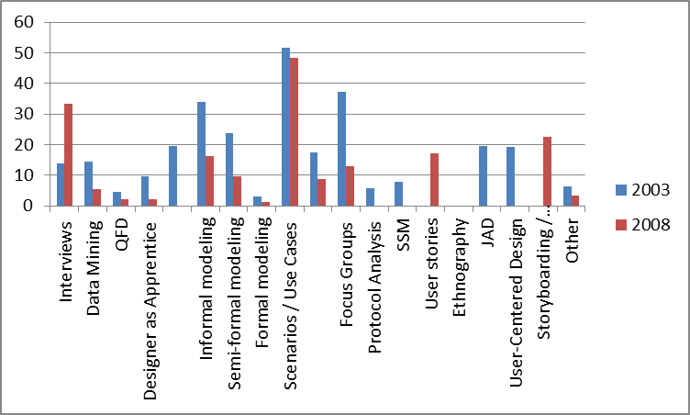
Requirements Elicitation Techniques Usage
Source: (Neill 2003), (Marinelli 2008)

Slide 64
Combining Elicitation Techniques
Decomposition of goals into detailed requirements
Prioritized lists of features
Documenting observed scenarios [observations + scenarios]
Others?
GOOD: workshop + goals , questionnaire + introspection , scenarios + viewpoints , etc
BAD- workshop + viewpoints [board members get data which they are not concerned with] , etc
Advantages , what techniques work for scenarios etc.

Slide 65
Backup Slides

Slide 66
Quality Function Deployment
“…a method for developing a design quality aimed at satisfying the consumer and then translating the consumer’s demand into design targets and major quality assurance points to be used throughout the production phase…” (Akao, 1990)
Provides a structure for ensuring that customers’ wants and need are carefully heard, then directly translated into a company’s internal technical requirements – from analysis through implementation to deployment.

Slide 67
Background of QFD
First introduced by Yoji Akao in 1966.
Applied to manufacturing, heavy industry and systems engineering at first.
Applied to software systems by IBM, DEC, HP, AT&T and Texas Instruments

Slide 68
QFD Process …
The basic idea of QFD is to construct relationship matrices between customer needs, technical requirements, priorities and (if needed) competitor assessment.

Slide 69
… QFD Process
To achieve this the following process is prescribed:
Identify stakeholder’s attributes or requirements.
Identify technical features of the requirements.
Relate the requirements to the technical features.
Conduct an evaluation of competing products.
Evaluate technical features and specify a target value for each feature.
Prioritize technical features for development effort.

Slide 70
QFD Process …
2
How’s
What’s
Relationship
matrix
Importance
weighting
Competitive
weighting
4
3
Target values
1
Competitive eval.
5
Importance weighting
6

Slide 71
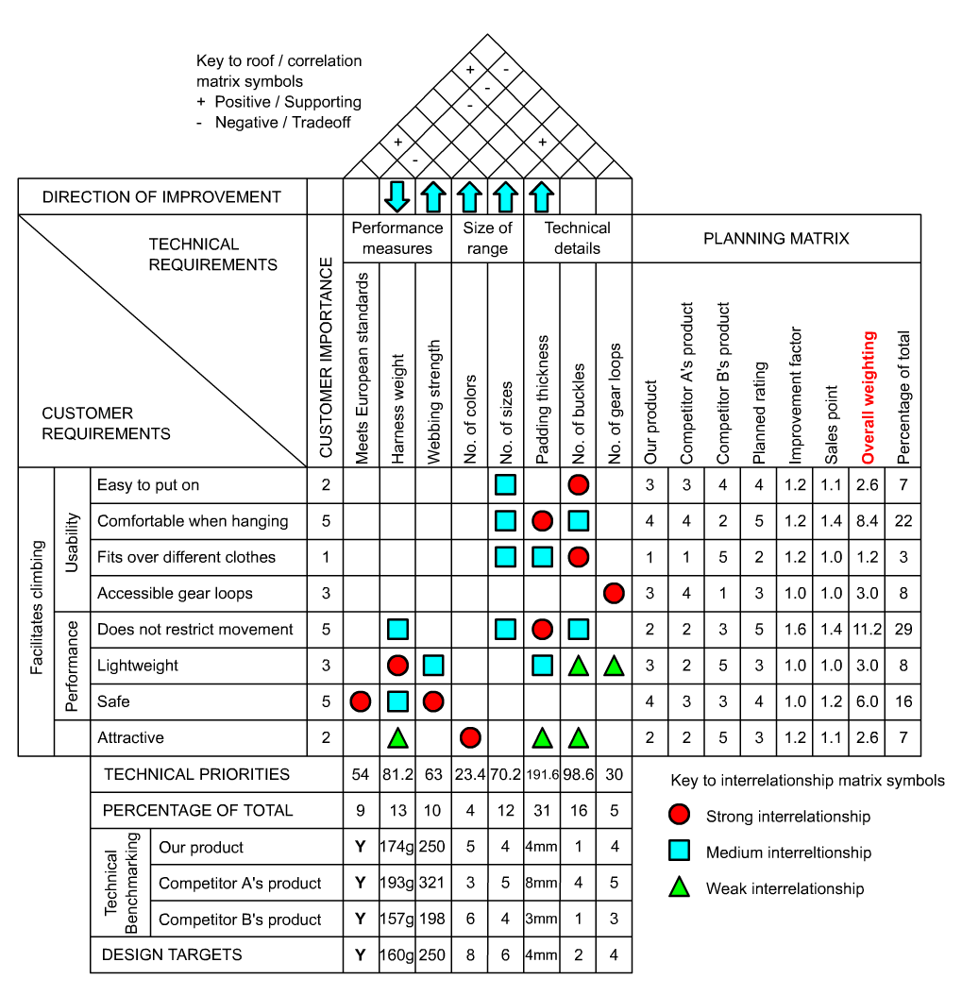
4-3=1
1/5+1=1.2
2*1.2*1.1=2.6
2.6*3+8.4*3+
1.2*3+11.2*3=
70.2
(9)
(3)
(1)

Slide 72
QFD Tutorial
http://www.webducate.net/qfd/qfd.html

Slide 73
Benefits of QFD
Improves user involvement
Structures communication processes
Provides a preventive tool for improving quality
Avoids loss of information

Slide 74
Drawbacks of QFD for Software Requirements Discovery
Difficulties in expressing temporal requirements.
Difficult to use with an entirely new project type (how do you discover customer requirements for something that does not exist, how do you build analyze the competitive products?).
Measurements for certain functions are hard to find.
The less we know the less we document.
It’s hard to keep the level of abstraction uniform.

Slide 75
Joint Application Design
Joint application design (JAD) is a process whereby highly structured group meetings or mini-retreats involving system users, system owners, and analysts occur in a single room for an extended period of time (four to eight hours per day, anywhere from one day to a couple weeks).
JAD-like techniques are becoming increasingly common in systems planning and systems analysis to obtain group consensus on problems, objectives, and requirements.

Slide 76
Joint Application Design Participants
Sponsor (top management, final say)
Leader (facilitator, independent)
Users and Managers (requirements, business rules)
Scribe(s)
Observer(s) (technical staff, development team)

Slide 77
Joint Application Design Sessions
Most JAD sessions span a three- to five-day time period and occasionally last up to two weeks.
The success of any JAD session is dependent upon proper planning and effectively carrying out that plan.

Slide 78
Planning the JAD Session
Before planning a JAD session, the analyst and sponsor must:
Determine the scope of the project.
It is also important that the high-level requirements and expectations of each JAD session is determined.
Ensure that the sponsor is willing to commit people, time, and other resources to effort.
Planning for a JAD session involves three steps:
Selecting location.
Selecting participants.
Preparing agenda.

Slide 79
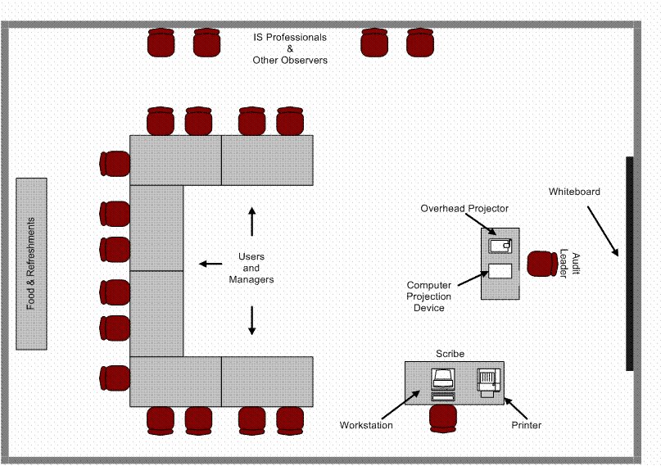
Room Layout for a JAD Session

Slide 80
Selecting Participants
Sponsor, analysts and managers select a leader.
Leader may be in-house or contracted in.
One or more scribes must also be selected.
Normally selected from the technical staff.
Technical staff are selected from the development team(s).
Analyst and managers must select individuals from the user community.
Should be knowledgeable about their business area and able to articulate it.

Slide 81
Conducting a JAD Session
Session begins with brief overview of agenda and objectives.
Leader should follow these guidelines:
Stick to agenda.
Stay on schedule (agenda topics are allotted specific time).
Ensure scribe is able to take notes.
Avoid technical jargon.
Resolve conflicts (try not to defer).
Encourage group consensus.
Encourage user and management participation without allowing individuals to dominate the session.
Make sure that attendees abide by the established ground rules.

Slide 82
JAD Document
The end product of a JAD session is typically a formal written document.
Essential in confirming the specifications agreed upon during the session(s) to all participants.
Content and organization of specification obviously dependent on objectives of session.
Analyst may choose to provide different set of specifications to different participants based upon their role.

Slide 83
Benefits of JAD
An effectively conducted JAD session offers the following benefits:
JAD actively involves users and management in the development project (encouraging them to take “ownership” in the project).
JAD reduces the amount of time required to develop systems.
When JAD incorporates prototyping as a means of confirming requirements and obtaining design approvals, benefits of prototyping are realized.

Slide 84
Drawbacks of JAD
Difficulty in committing sufficient time (and lots of people).
Tendency to bog down trying to get the model perfect.
Volume of information generated can be overwhelming.
Some observe that the time and cost does not justify the results.
Source: Davidson

